Slide 1
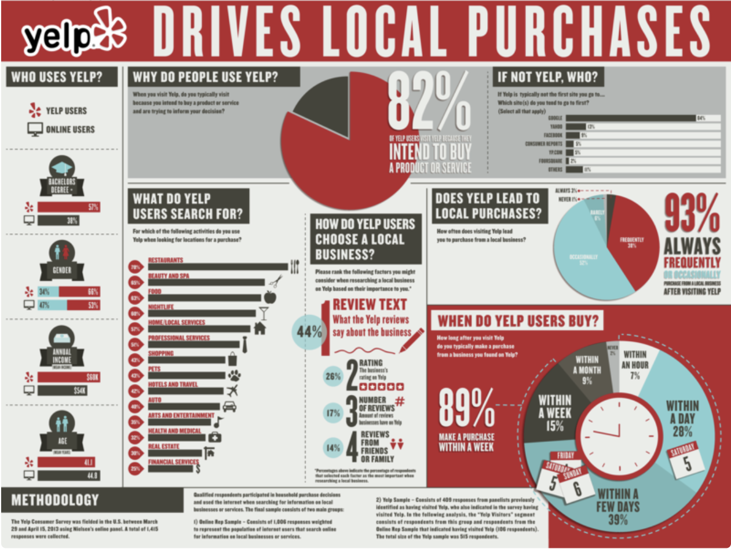
Yelp Review Rating Prediction
PRESENTED BY:
LI LIPING (A0186040M)
REN JIEWEN (A0186102N)
WANG XINRUI (A0186103M)
XIAO RUI (A0186000W)
Notes:
Jiewen
Behalf

Slide 2

Overview
DSC 5103 Statistics
Overview of Problem
Data Pre-processing
Model Results
Conclusion

Slide 3
Overview of Problem
DSC 5103 Statistics
Section
1
Notes:
Why is review rating prediction important?
Imagine this, this classroom has turned into new fancy restaurant when you can enjoy a great meal, exceptional service - and it only cost you a plate a chicken rice, will this be the first thing you go home and tell your roommates tonight? It will be, right?
When you go to a new restaurant and have a good experience, it's likely that you won't keep the place a secret. And this kind of communication decides whether a business lives and dies.
These reviews influence people’s purchase behavior to a large extent.
Amazon/Lazada - it is impossible to read thousands of reviews, and tend to look at the star ratings and ignore its textual reviews.

Slide 4
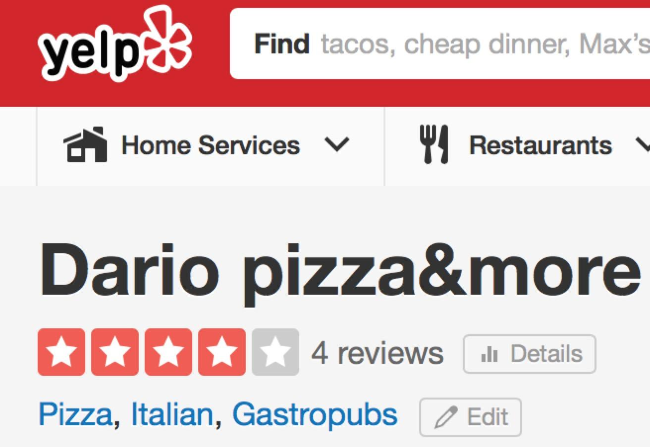
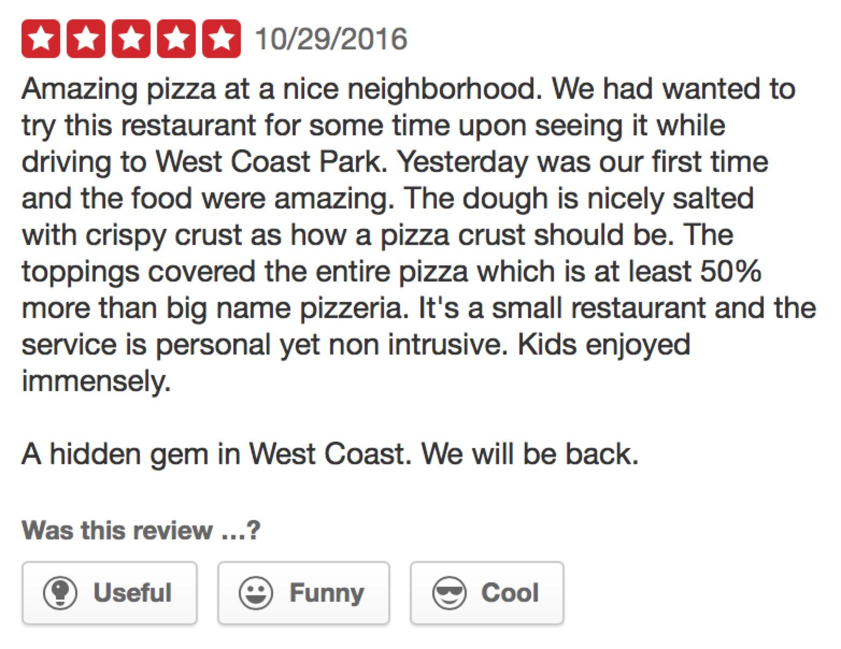
Try to answer…
What are potential variables correlated with ratings?
How well can we predict the rating by a customer?
Business value…
Restaurants
Yelp
Notes:
For businesses: improvements
For Yelp: know its users better, optimize recommendation system
Optimal Goal: create a model to predict the rating a user would assign to a business.

Slide 5
Data Pre-processing
DSC 5103 Statistics
Section
2
Notes:
Downloaded from Kaggle competition held in 2013

Slide 6
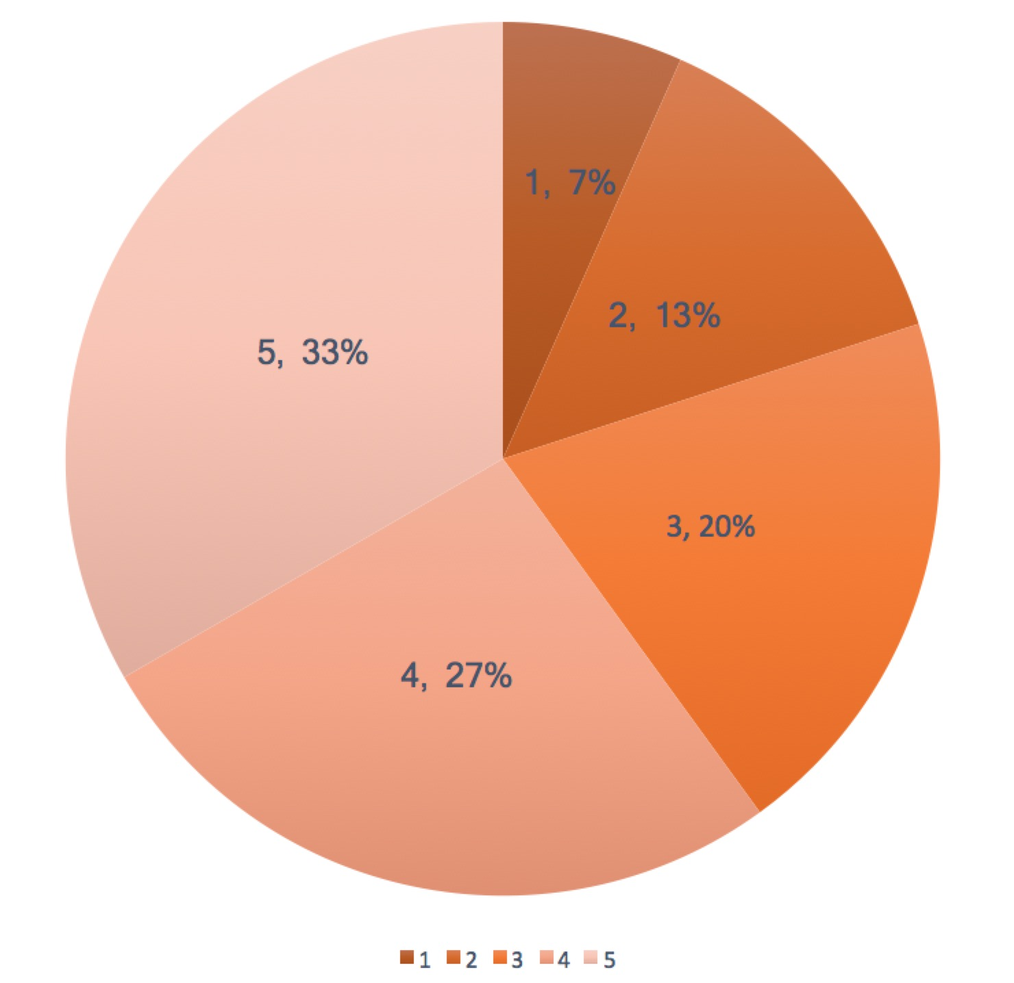
Yelp Dataset 2013 Sample
31,693
4,362
14,893
DSC 5103 Statistics
samples
Restaurants
Distribution of review stars
Customers
Notes:
After we merged and cleaned the data -
geographic of restaurants: spread near Phoenix
distribution of stars: not normal distribution

Slide 7
Feature Selection
DSC 5103 Statistics
Related to the review:
text, vote.funny, vote.cool, vote.useful
Related to the customer:
funny, cool, useful, review.count
Related to the restaurant:
city, category, review number

Slide 8
Feature Construction
cuisine
wcount
qmark & emark
DSC 5103 Statistics
25 cuisines summarize 204 categories of restaurants in original dataset
city
10 levels summarize 46 cities, most of which are in Arizona
Total number of words in each review text
Total number of question/exclamation marks in each review text

Slide 9
Model Results
DSC 5103 Statistics
Section
3

Slide 10
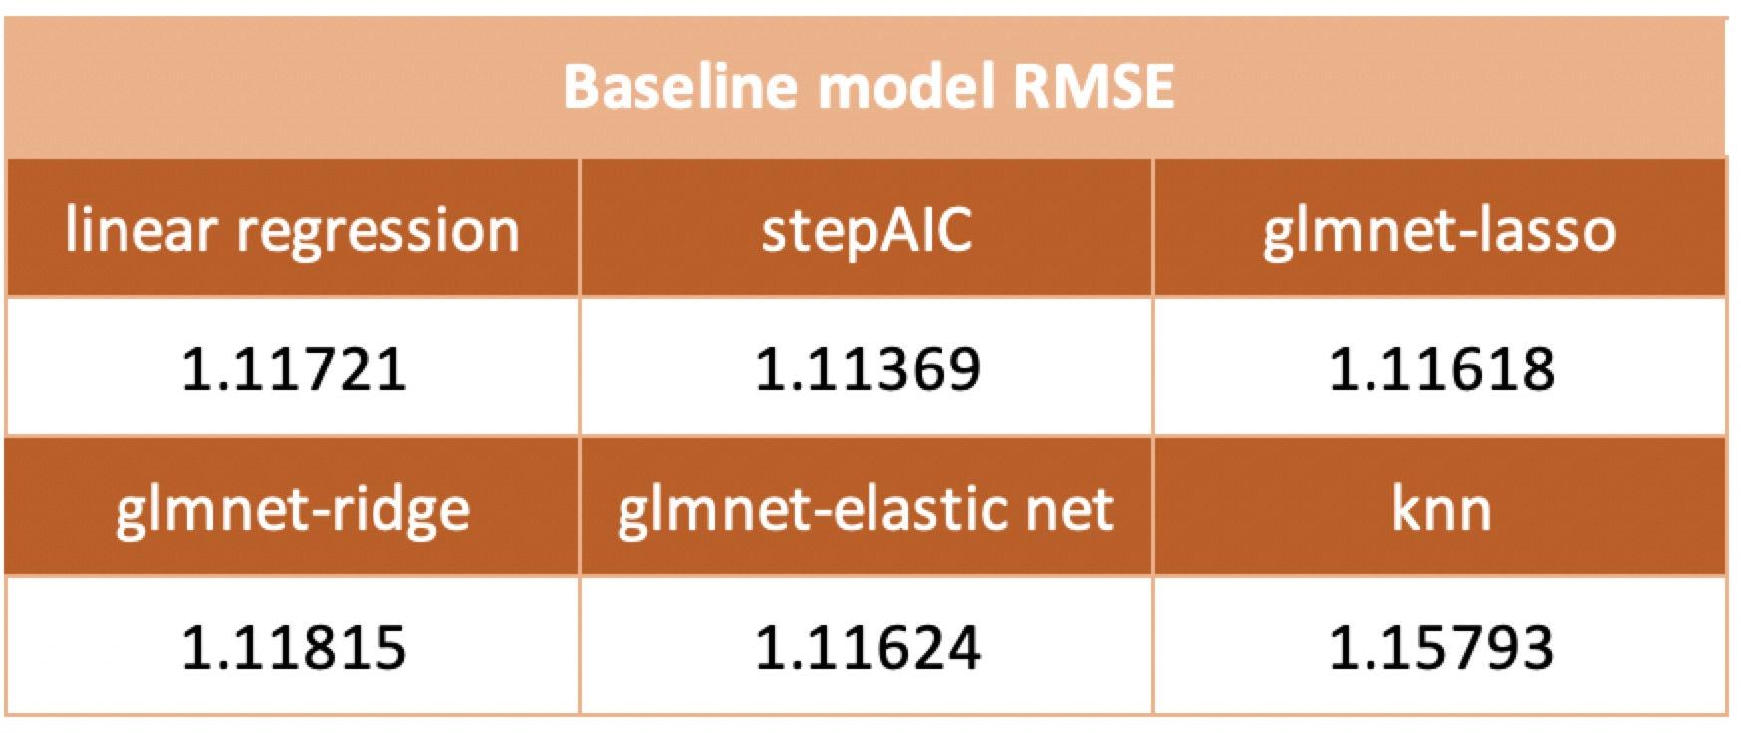
Baseline Model Results
DSC 5103 Statistics

Slide 11
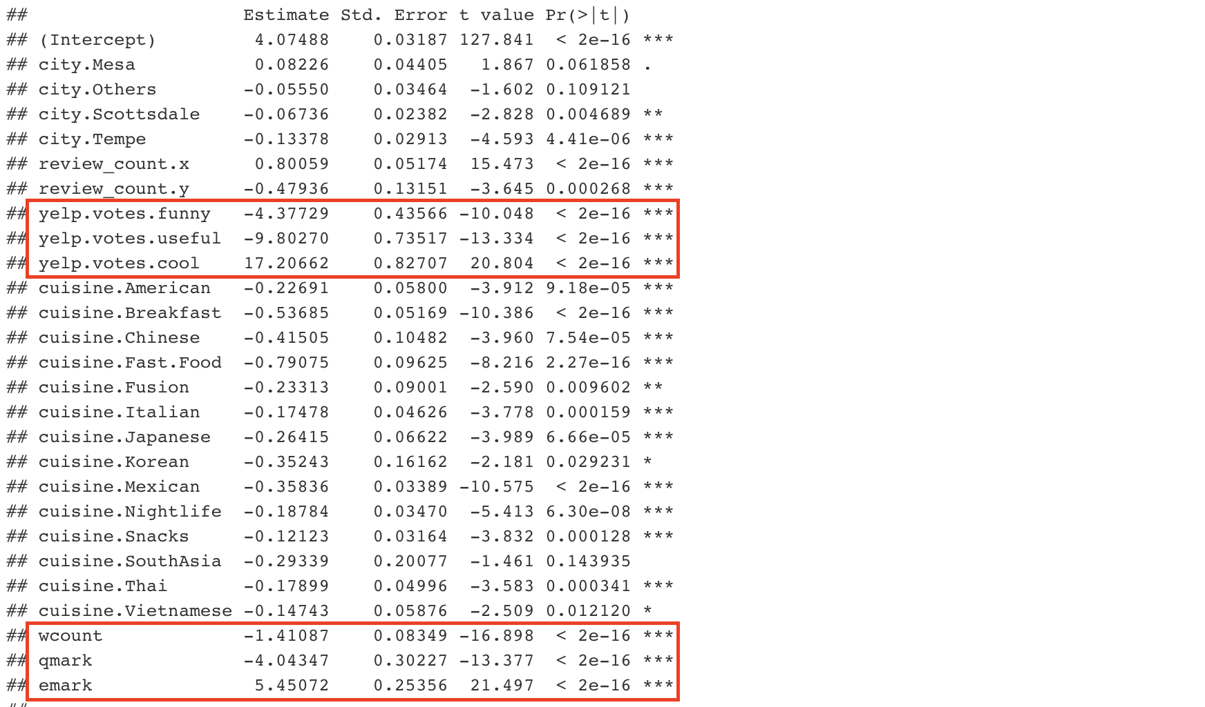
Baseline Model Interpretation
DSC 5103 Statistics
Coefficient of 6 variables
Positive or negative?
Statistically significant

Slide 12
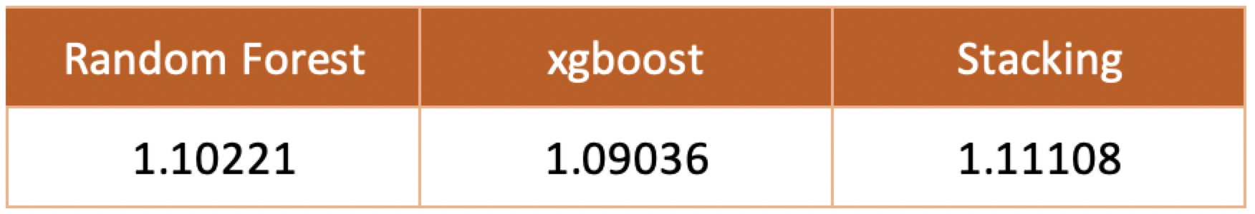
Ensemble Learning Results
DSC 5103 Statistics
Stacking:
level 0 - Random Forest, Xgboost, Step_AIC and Elastic net
Meta-learner - Lasso regression

Slide 13
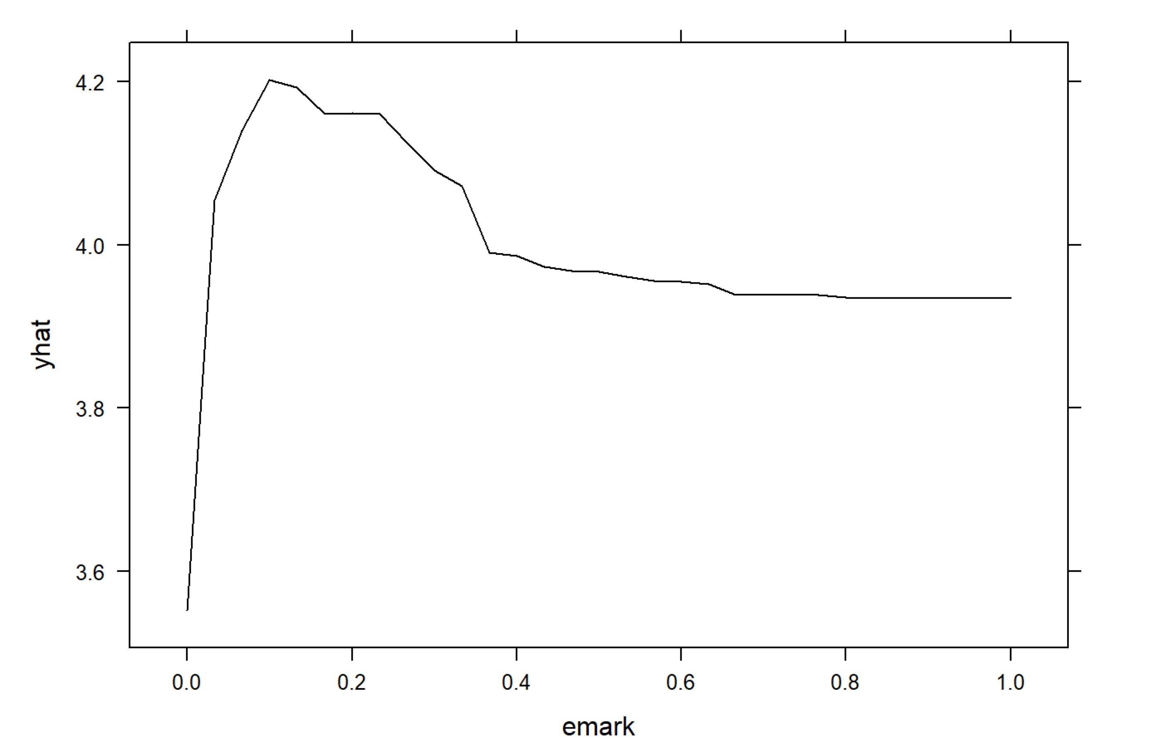
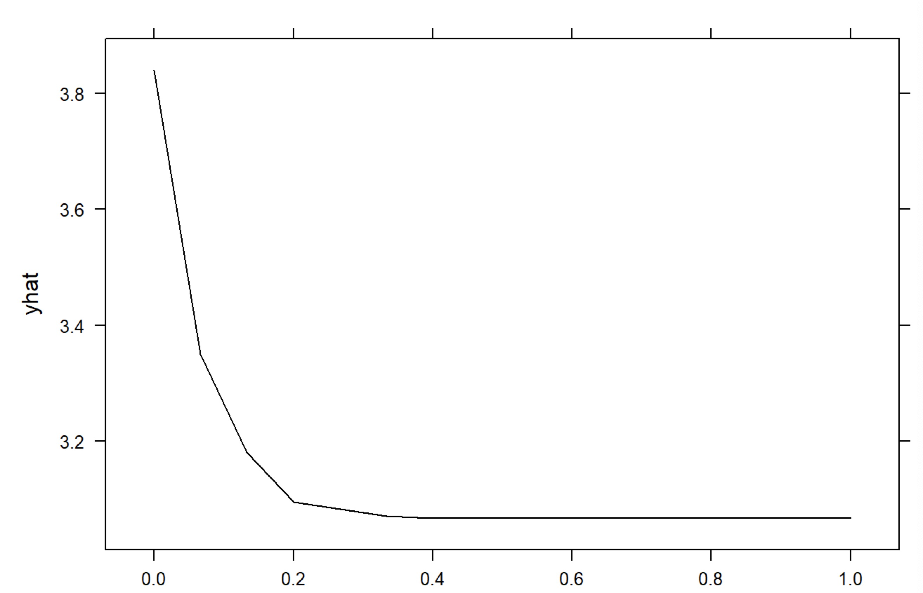
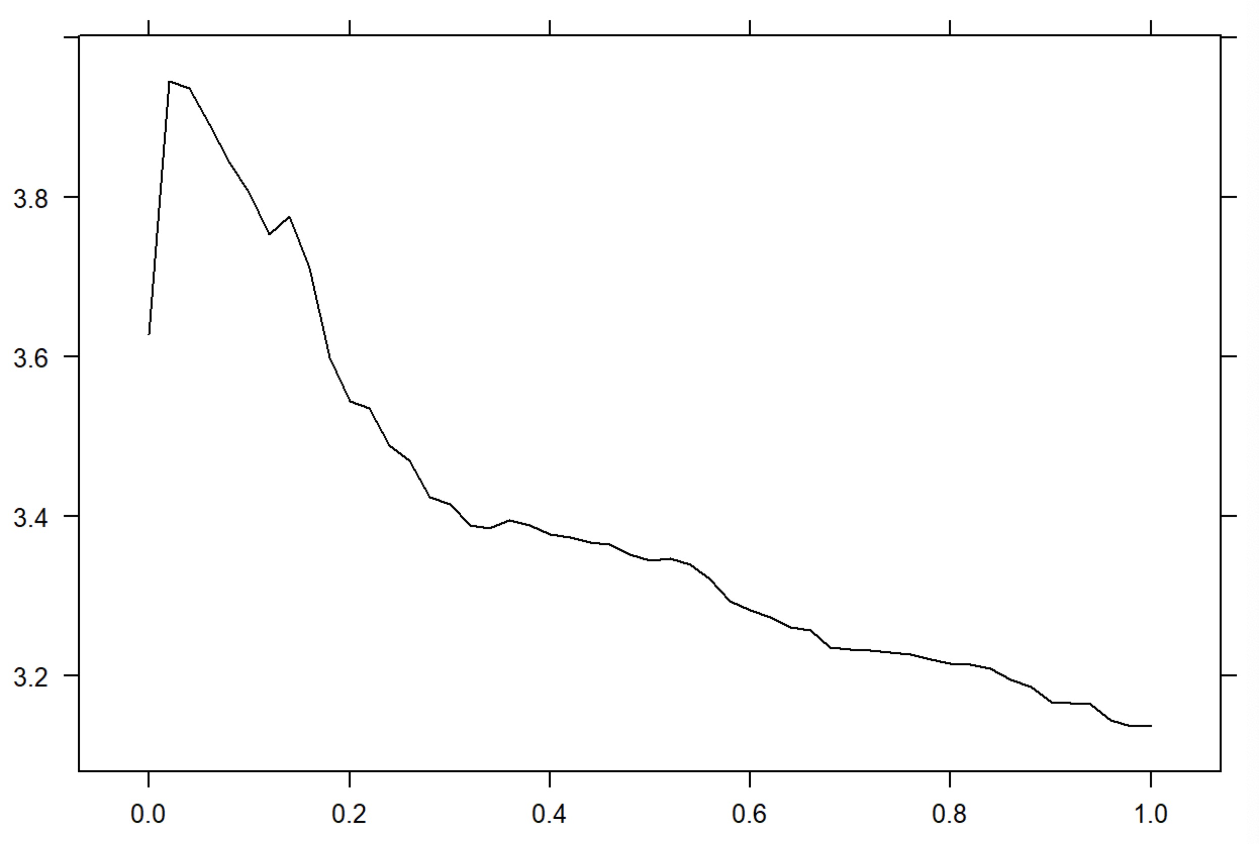
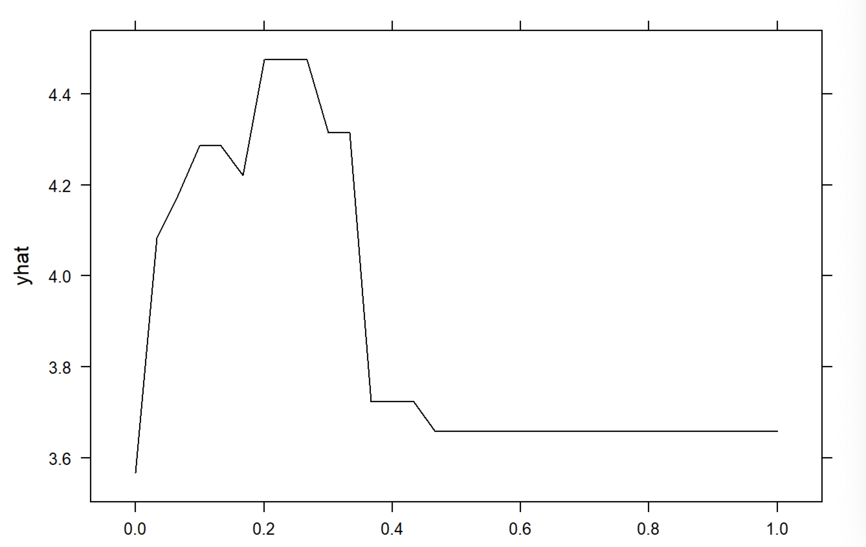
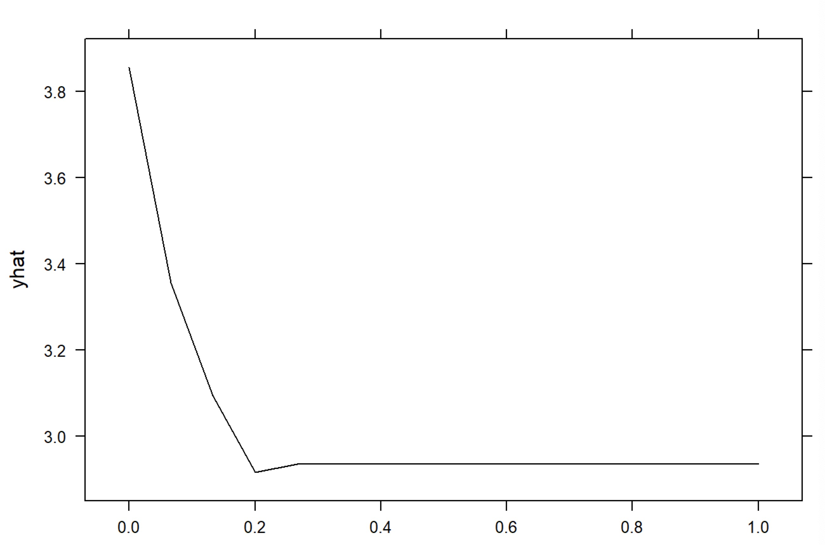
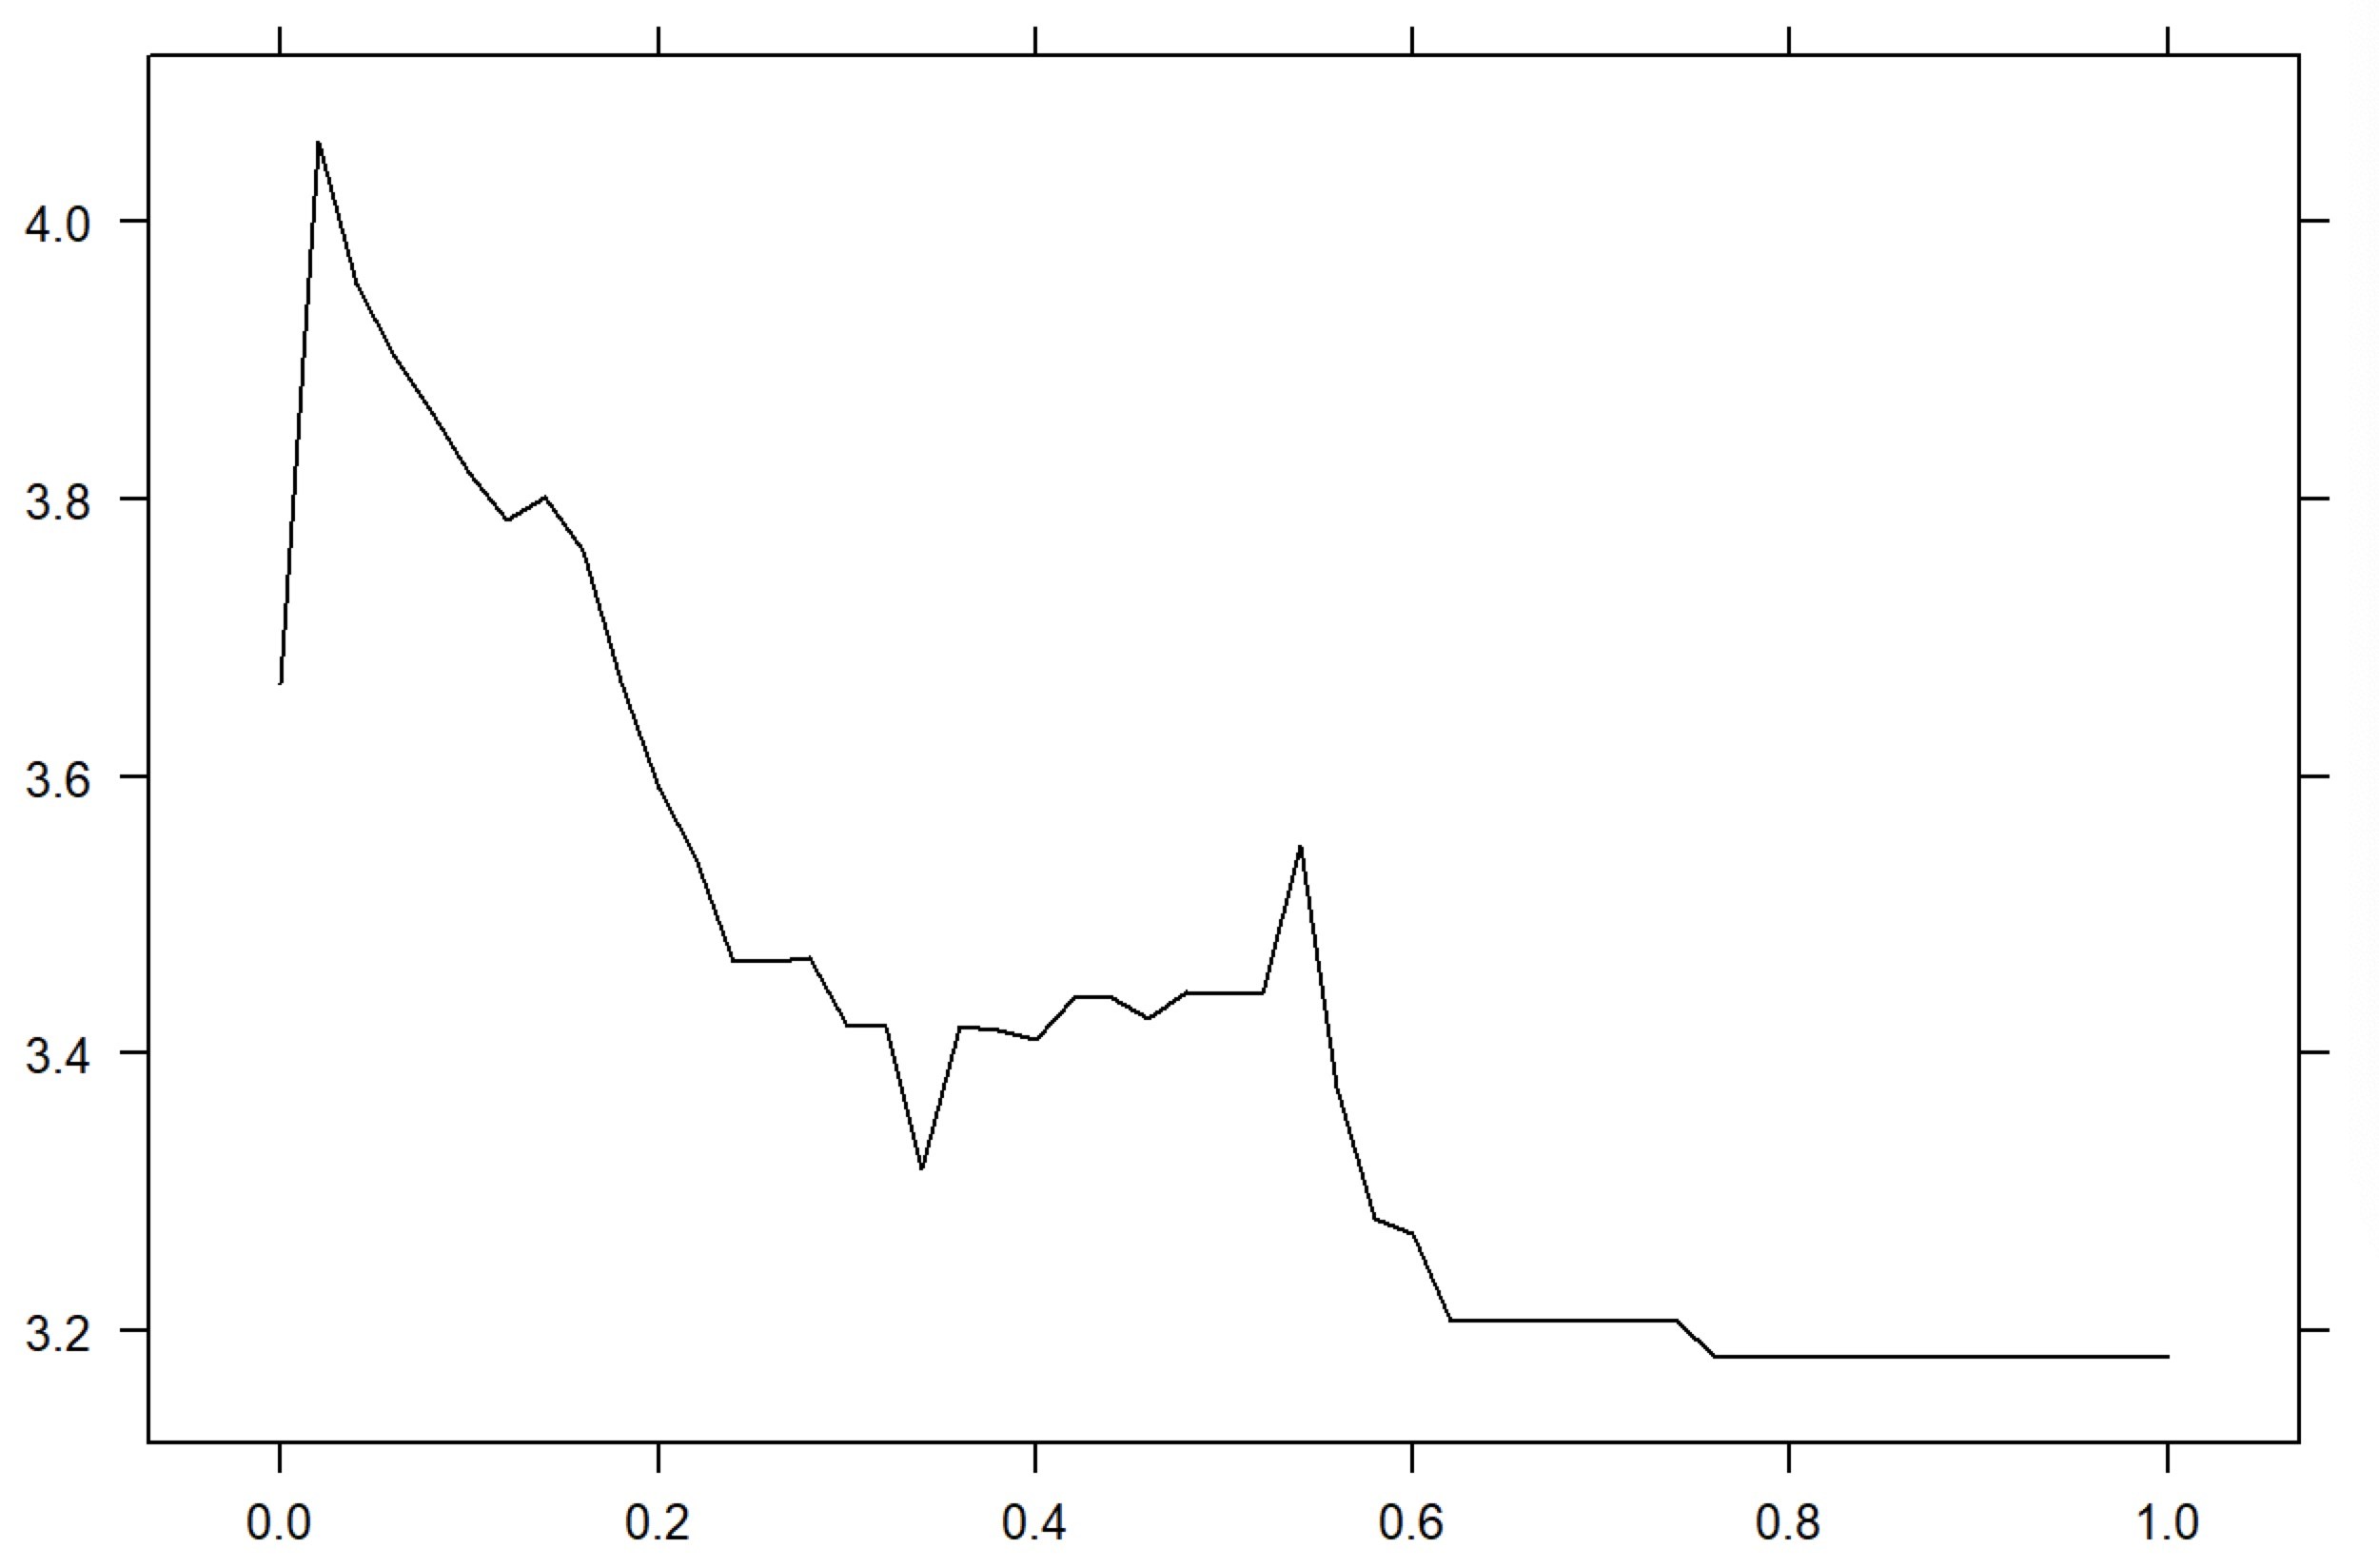
Variable Importance – Partial Plot I
DSC 5103 Statistics
Random Forest
Xgboost
emark
qmark
wcount

Slide 14
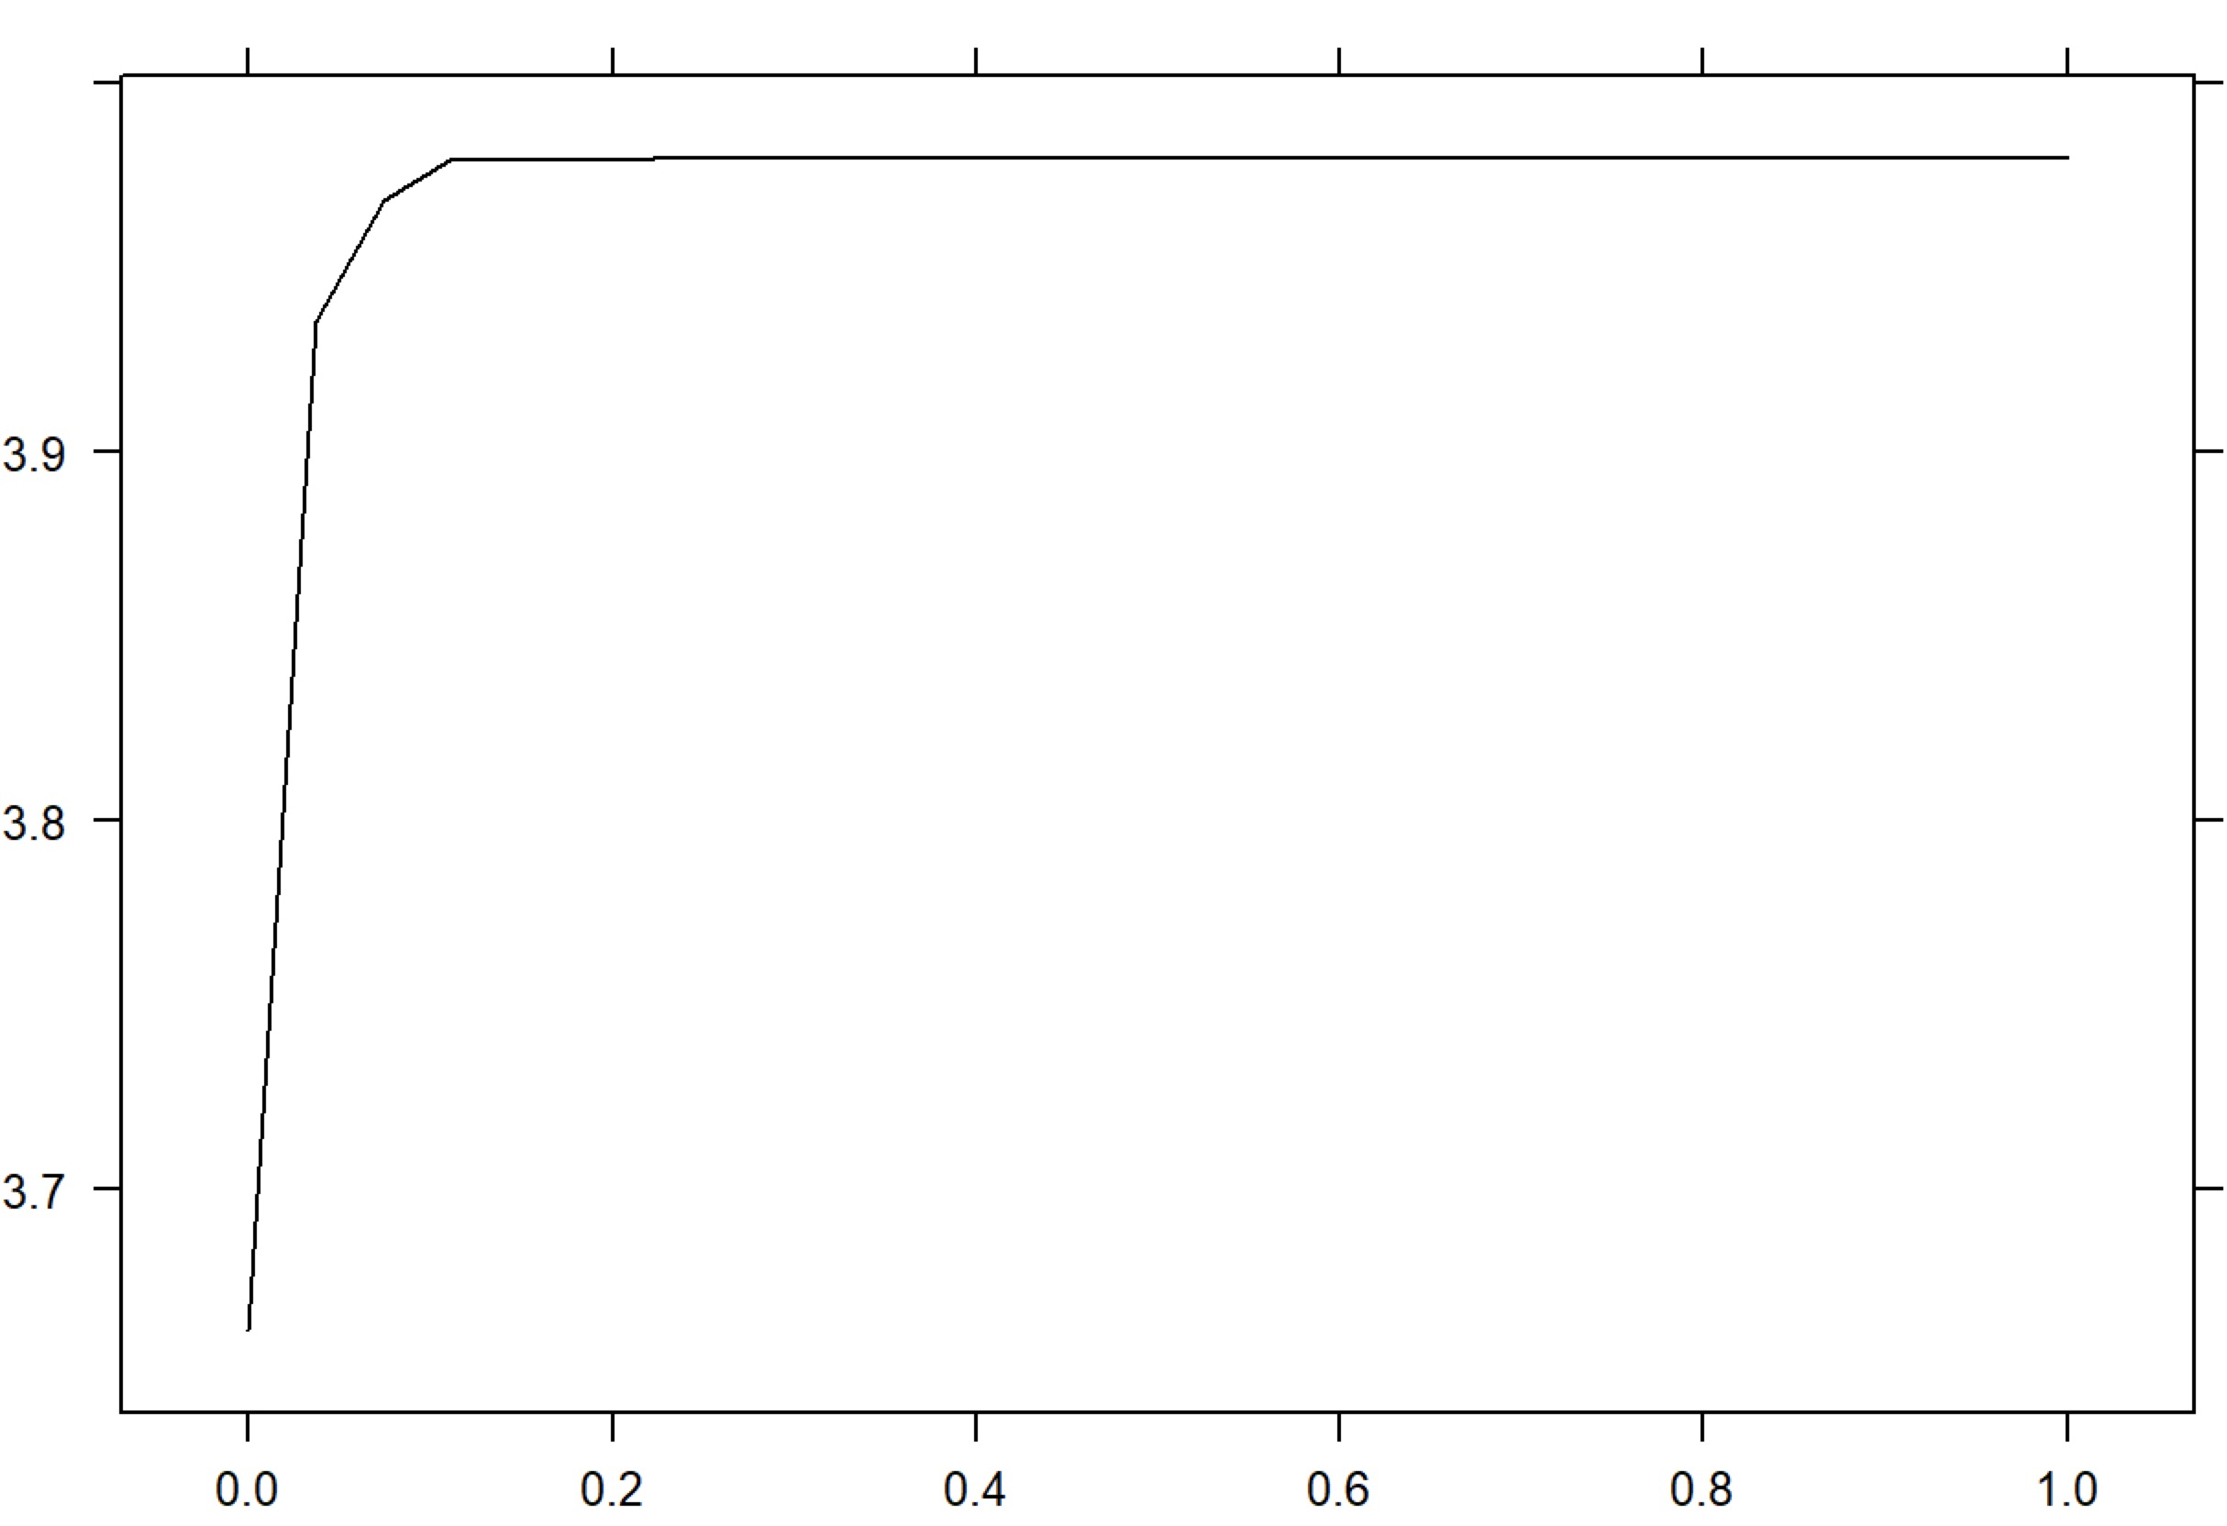
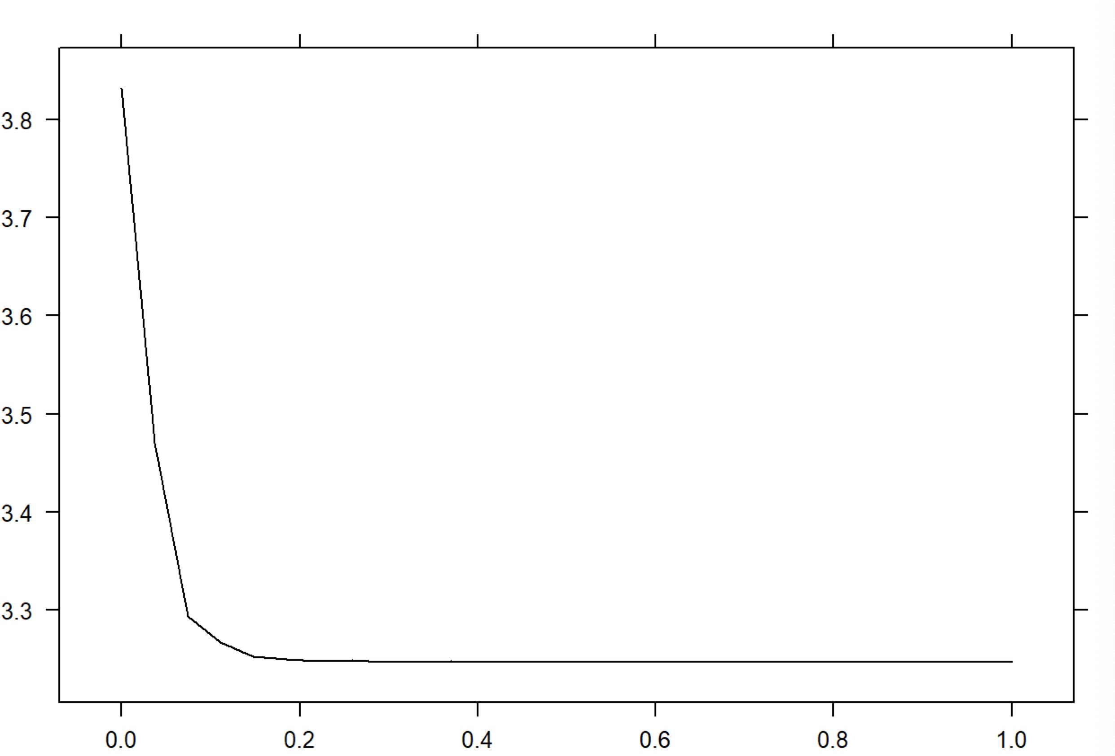
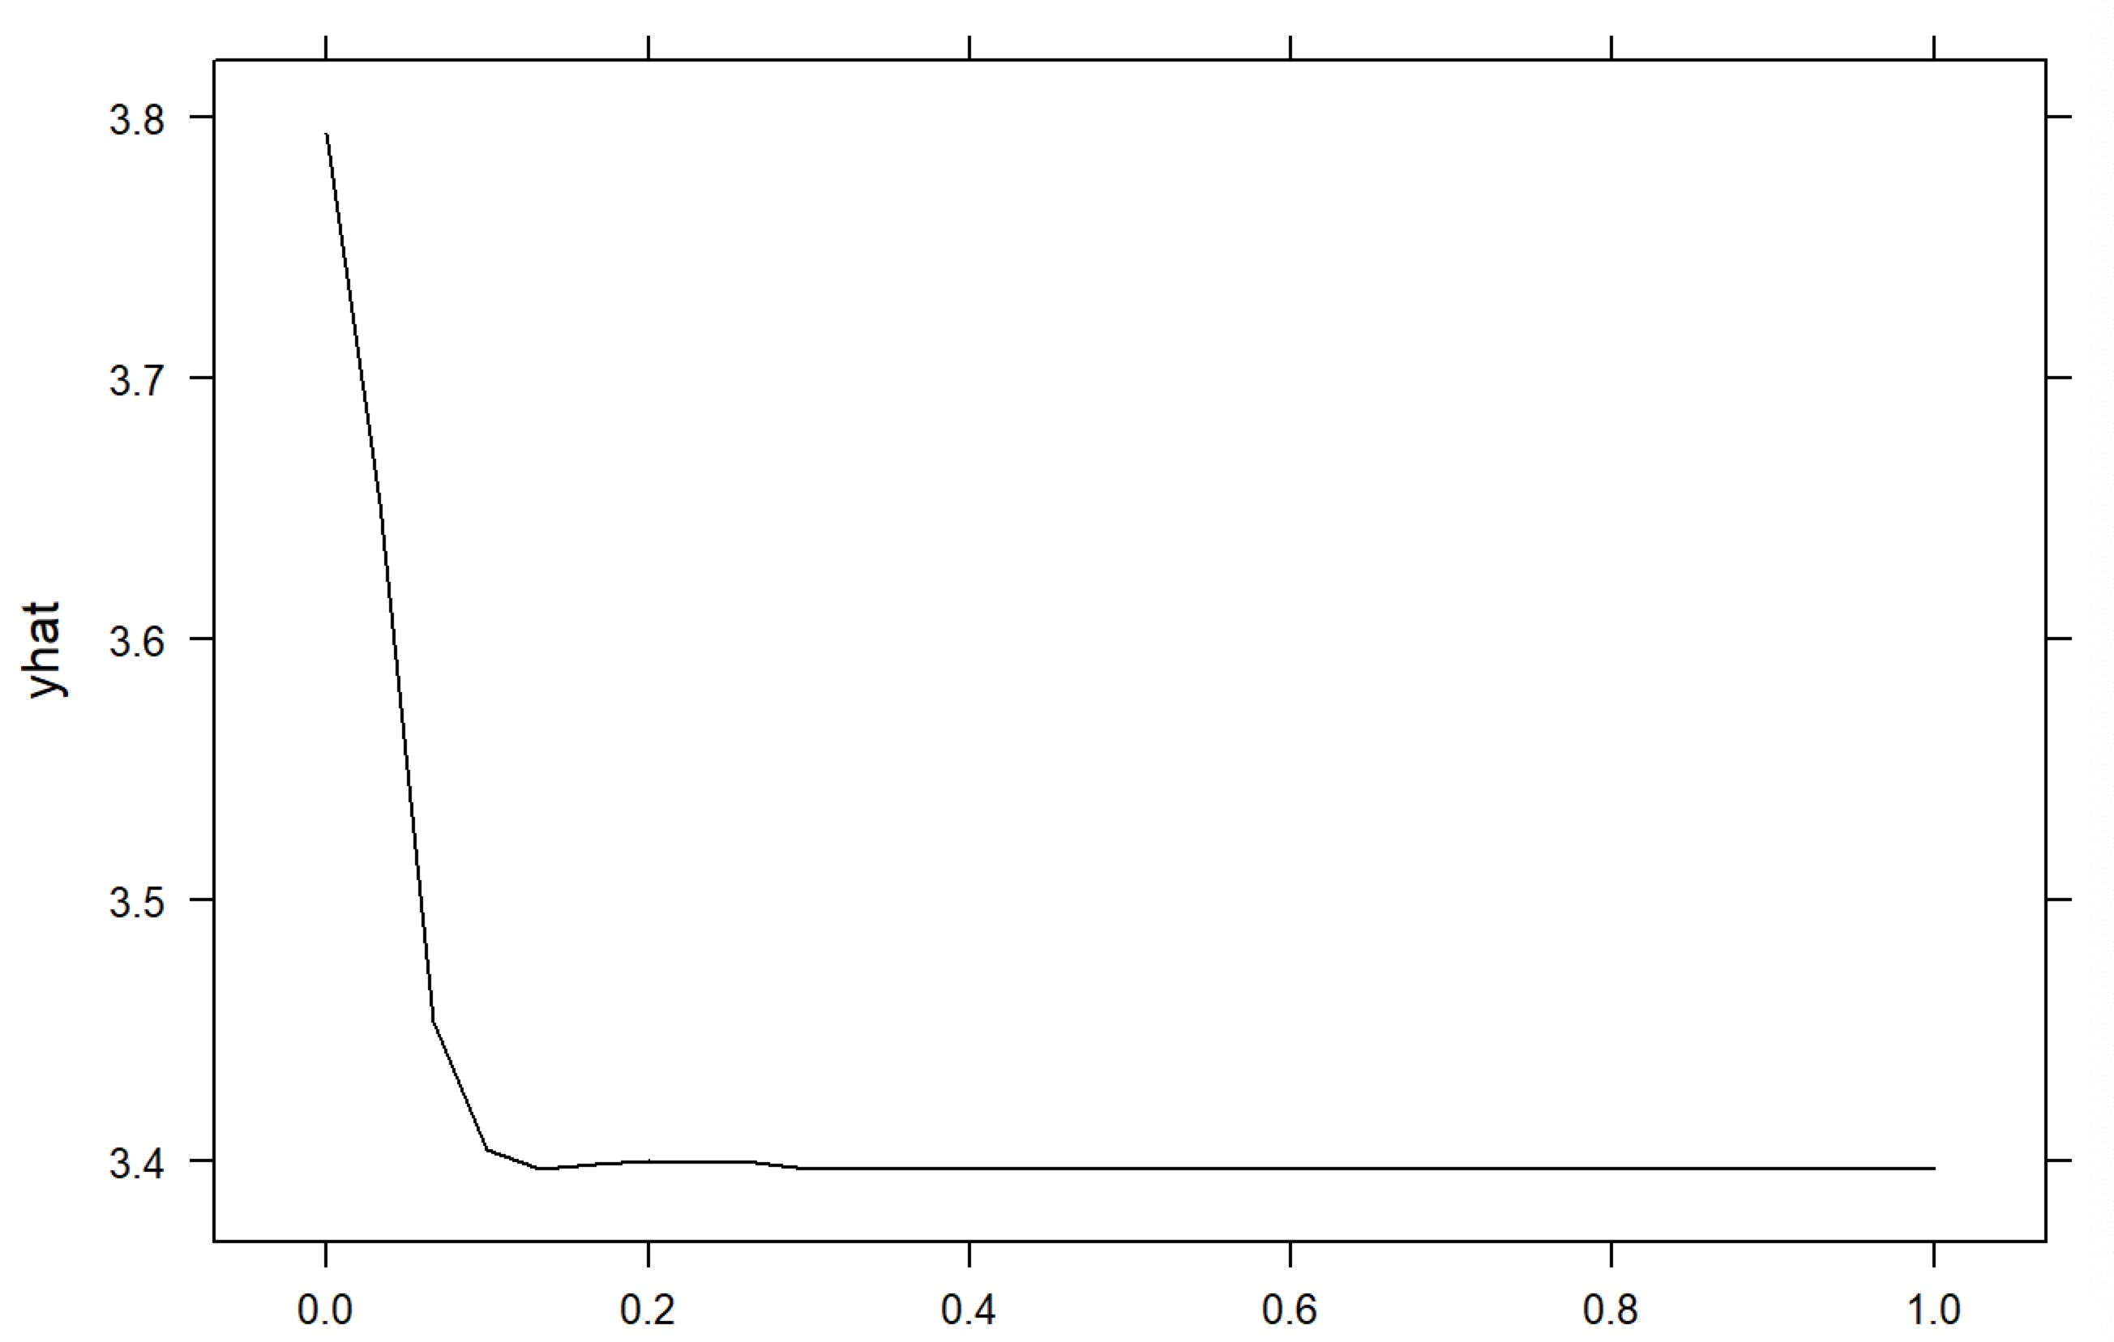
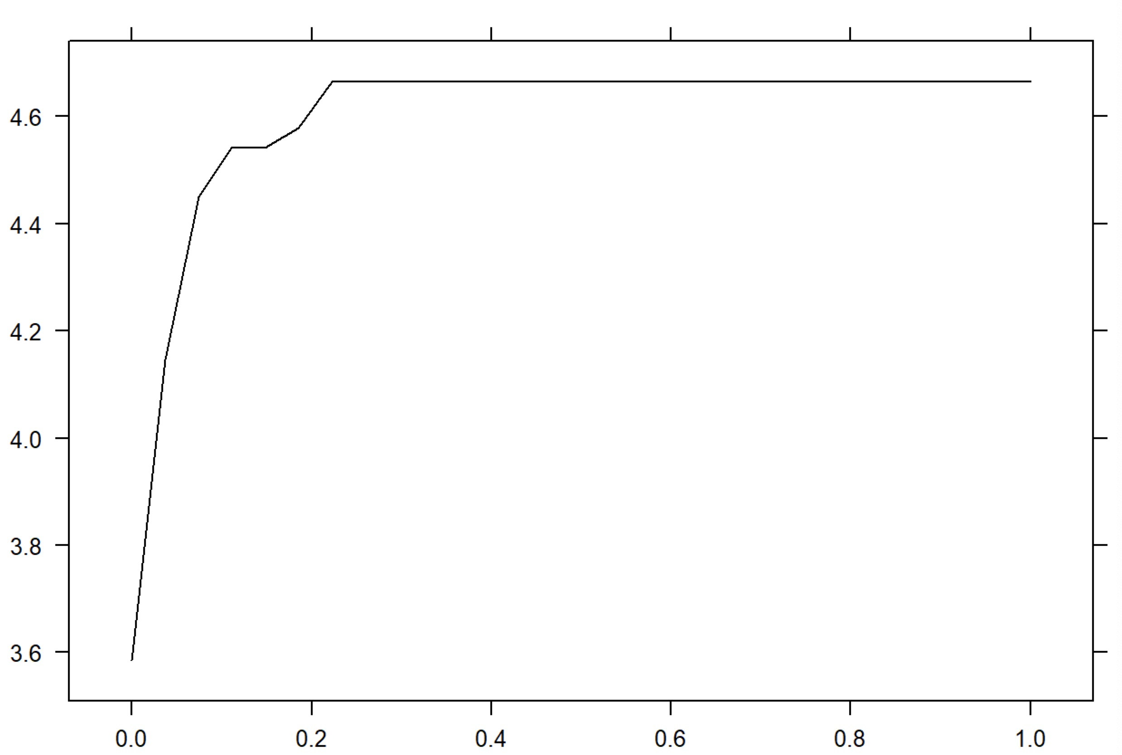
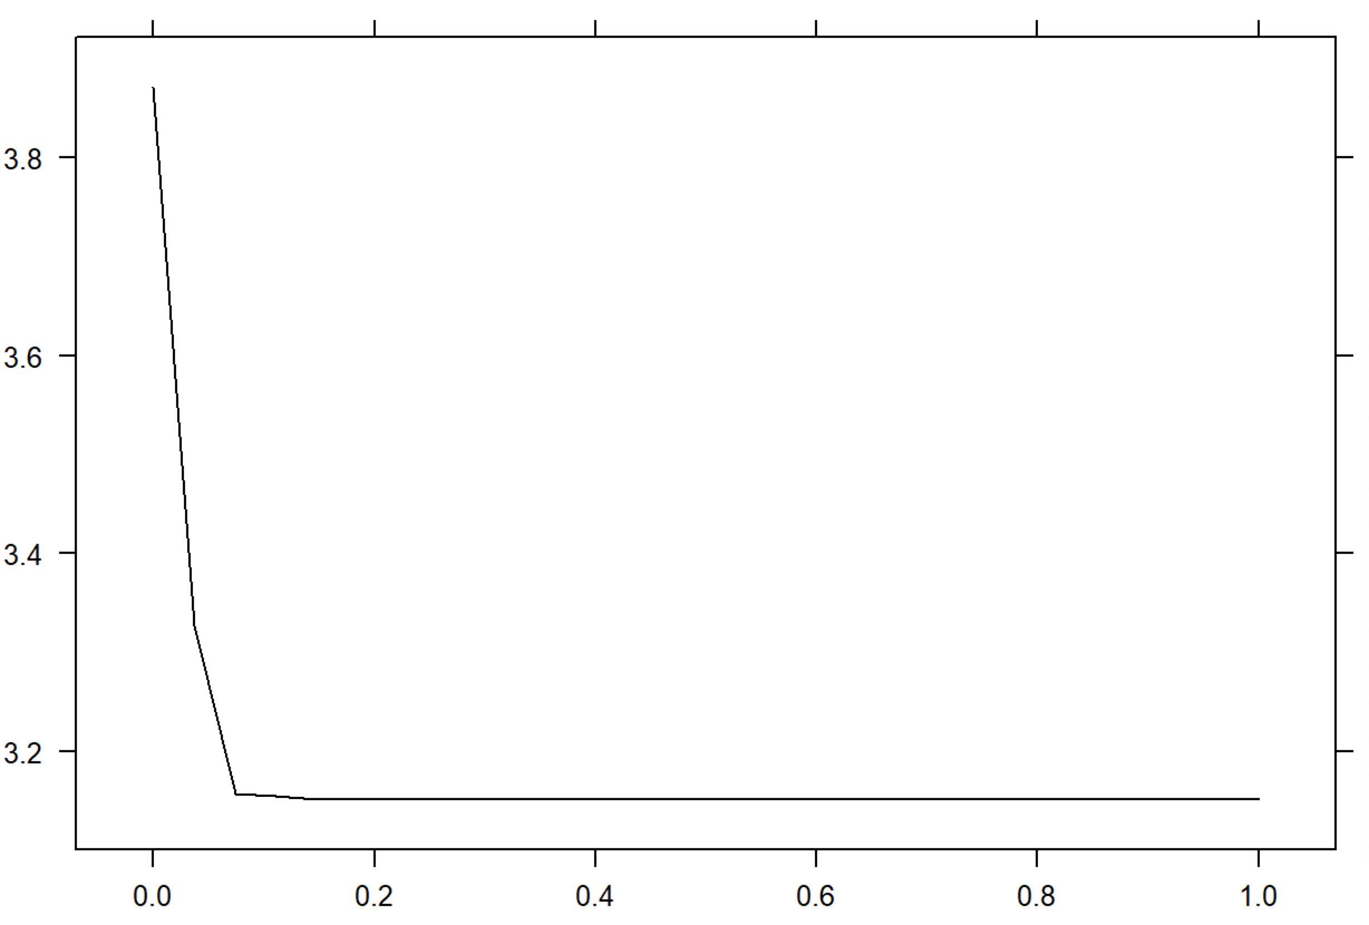
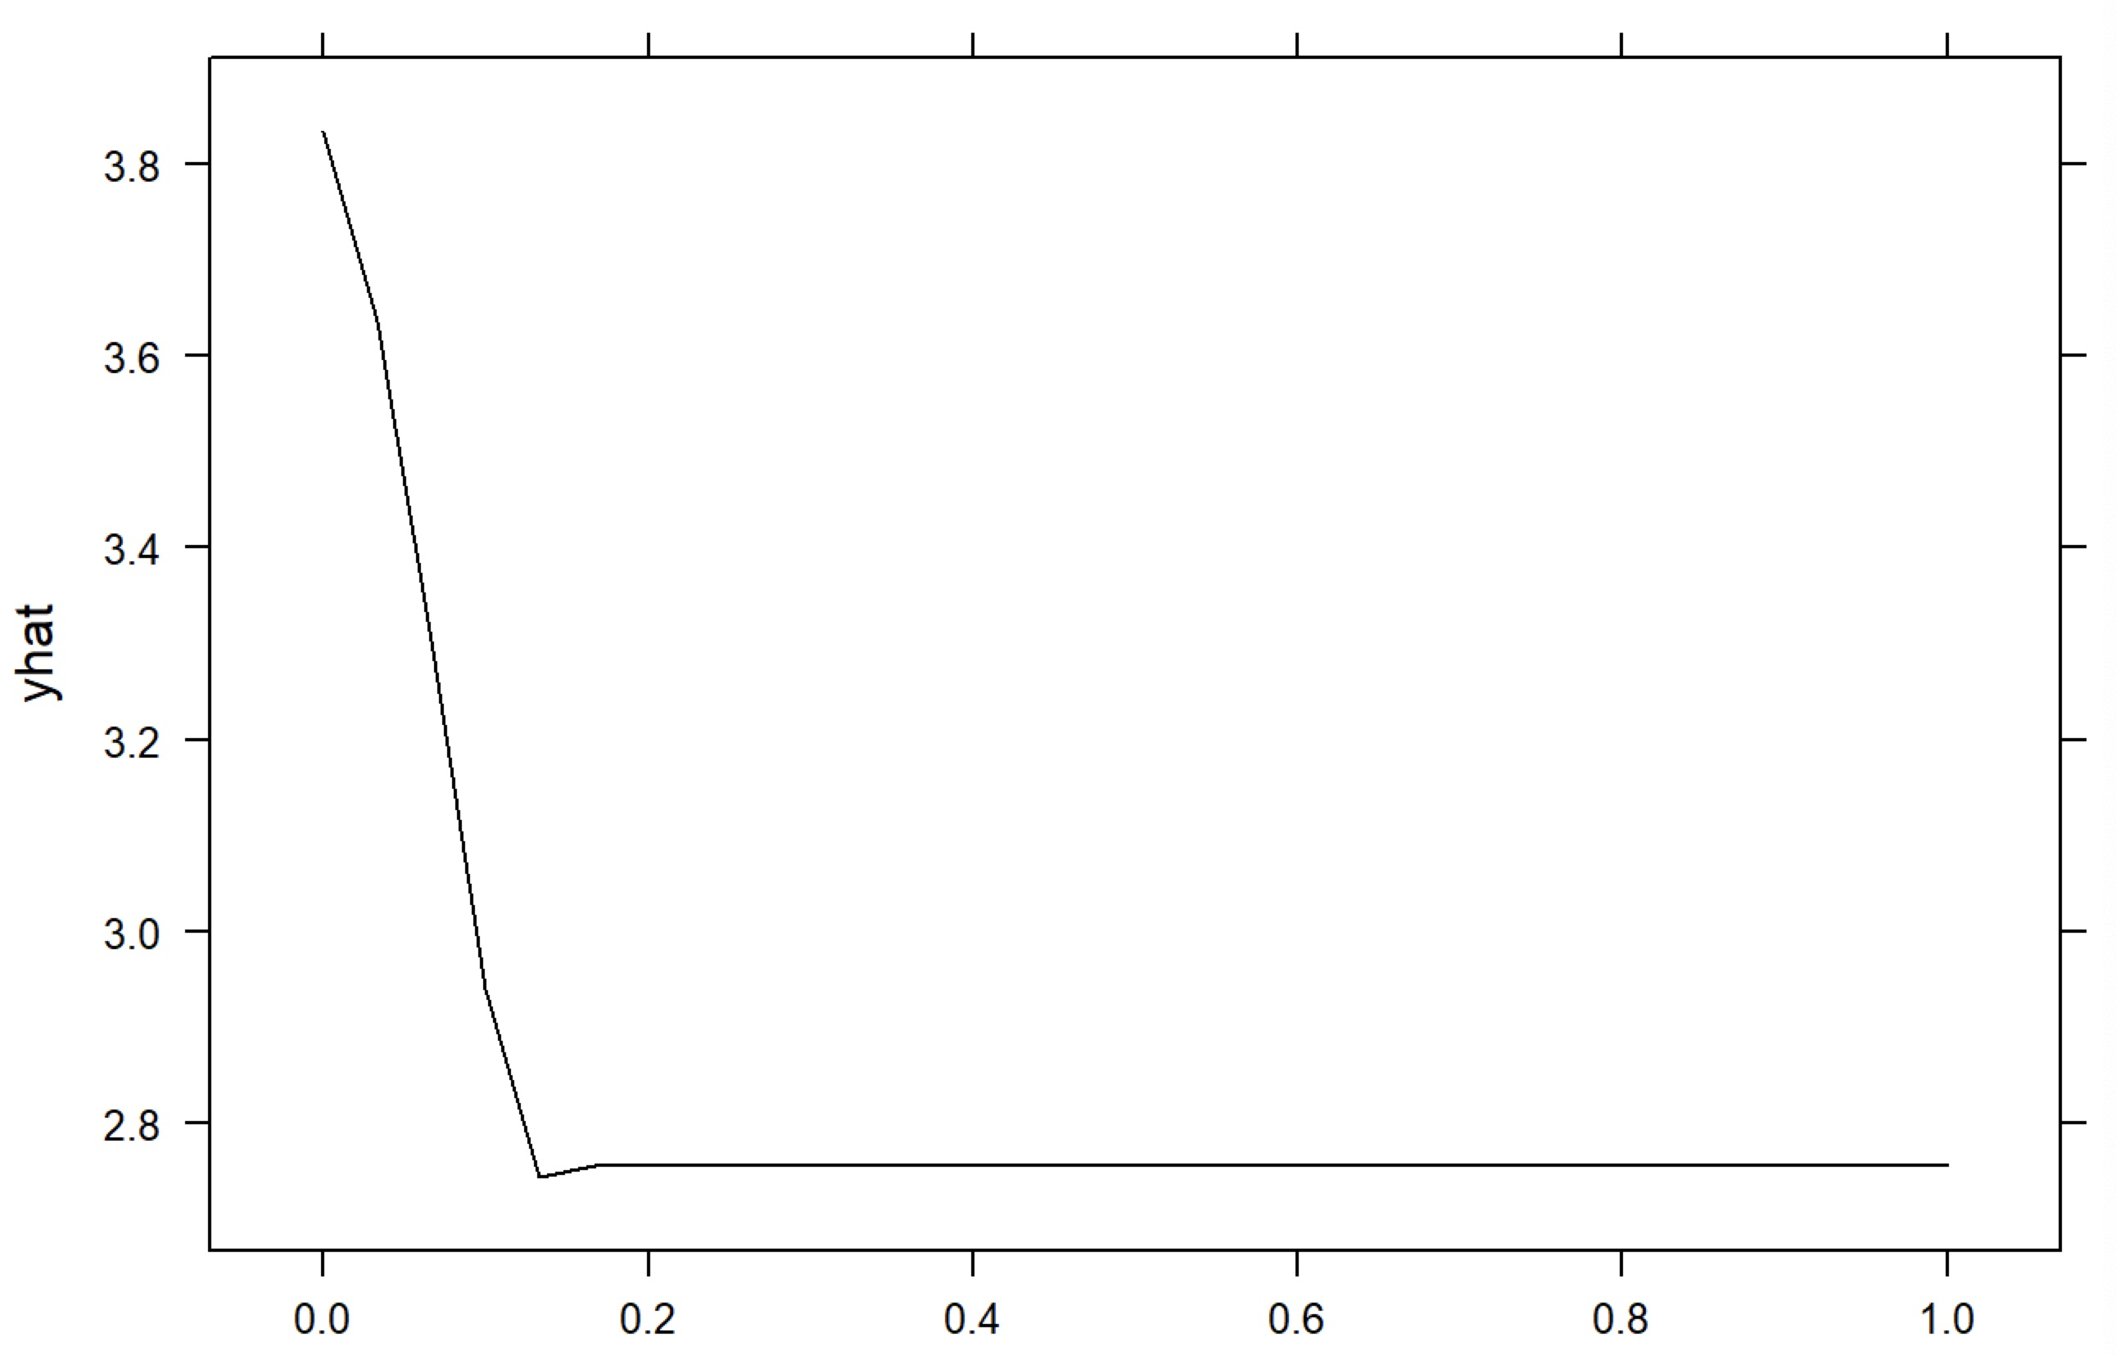
Variable Importance – Partial Plot II
DSC 5103 Statistics
Random Forest
Xgboost
yelp.votes.cool
yelp.votes.funny
yelp.votes.useful

Slide 15
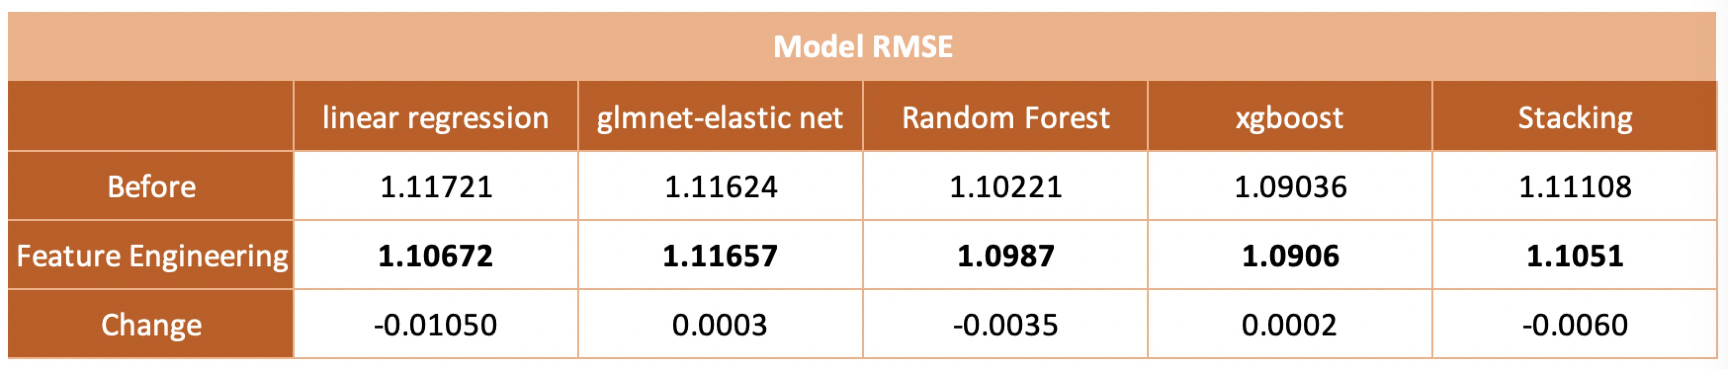
Feature Engineering Results
DSC 5103 Statistics

Slide 16
Conclusion
DSC 5103 Statistics
Section
4

Slide 17
1.0906
Our model’s lowest RMSE
From Xgboost after feature engineering

Slide 18
DSC 5103 Statistics
Algorithm selection: Xgboost performs the best
Text mining techniques
Extend prediction models to other business categories, such as shopping, hotels, etc.
Notes:
Tackled Review rating prediction as a numeric regression problem
Stacking performs the best
New features improve the model
Practical use

Slide 19
THANK YOU!

